Slide 1

Long Short Term Memory
Emmanuel Dufourq
African Institute for Mathematical Sciences
University of Cape Town

Slide 2
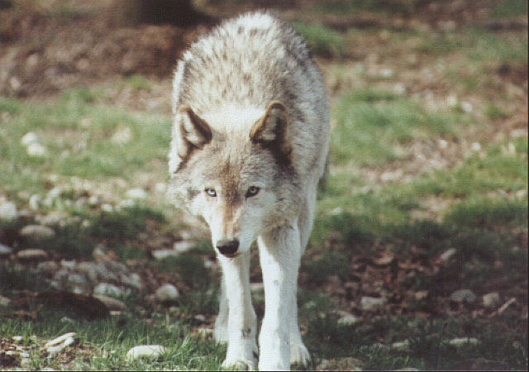

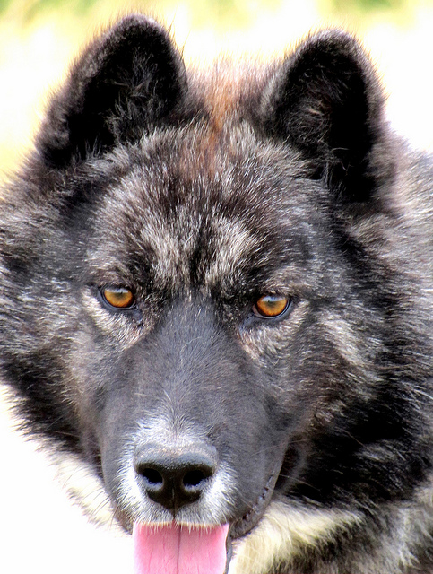
Idea – You’re walking in the forest
Flickr.com - Oregon Department of Agriculture
Flickr.com - Rover_Thor
Flickr.com - Robert Powroznik

Slide 3
Made up of 4 Primary Parts
Forget Gate | Remember Gate
Learn Gate | Output Gate

Slide 4
LSTM Cell Structure
Notes:
Arbitrary construction because it works

Slide 5
Forget Gate
Network can learn to forget information that causes incorrect predictions.
Notes:
Network learns what to throw away from the current cell state

Slide 6
Learn Gate
Finding out what we will store in the new cell state.

Slide 7
Remember Gate
Update the old cell with new information.

Slide 8
Output Gate
Output gate/use gate. Come up with new short term memory (i.e output).

Slide 9
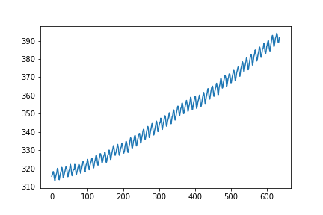
Problem
Carbon emission dataset:
Carbon emission for each month from 1959 to 2011
53 examples (rows - one for each year)
Each column in the data is the emission for each month – 12 features

